Slide 1
Federal and state policy matters: why it is important and how you can get involved
Aracely Navarro
Advocacy Coordinator
California Primary Care Association
Dan Rabbitt, MSW
Health Policy Organizer
National Health Care for the Homeless Council

Slide 2
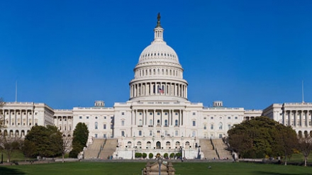
Federal legislative policy

Slide 3
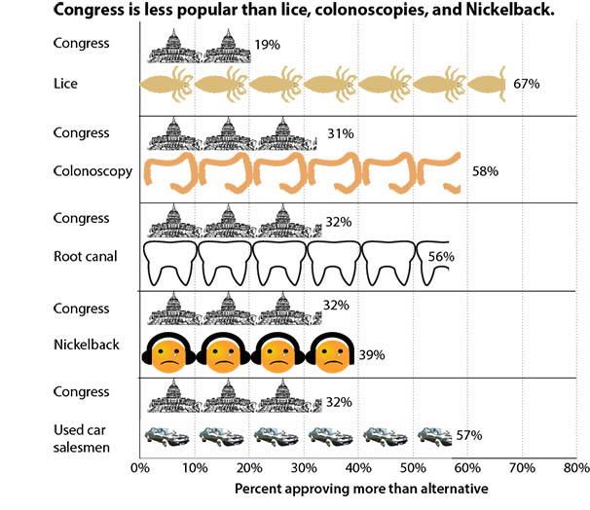

Slide 4
Federal legislative policy matters
HCH services depend on federal dollars
330(h) is the largest grant for most HCH projects
ACA health center funds have been only source of growth
Medicaid largest source of funding for health centers

Slide 5
Federal legislative policy matters
Ending homelessness requires
federal investment
Very little affordable housing is produced without HUD investment
Reduction in veteran homelessness shows what can be done with federal resources

Slide 6
Federal legislative policy matters
HCH consumers depend
on government programs
SNAP (food stamps)
SSI
Housing Choice Vouchers
Medicaid (Medi-cal)

Slide 7
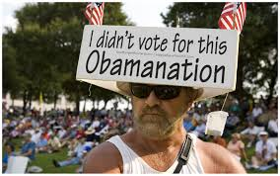
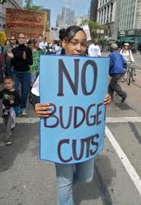
Recent history

Slide 8
Cut to health center funding
In 2011, a $1 billion cut to health centers was proposed
Intense advocacy reduced the cut to $600 million

Slide 9
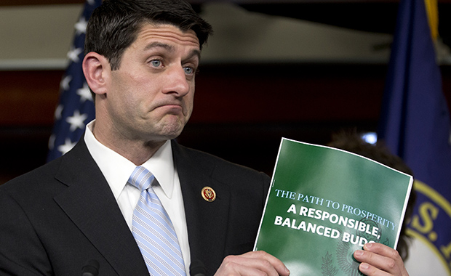
Recent house budgets
Repeals the ACA
Turns Medicaid and SNAP into block grants
70% of cuts come from safety net programs

Slide 10
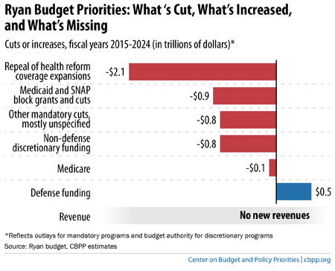

Slide 11
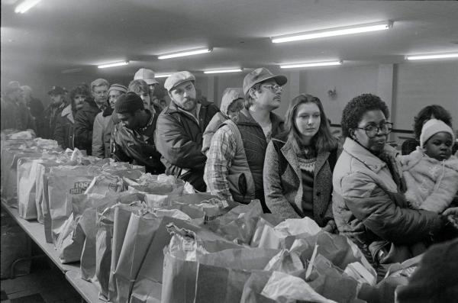
SNAP reauthorization
Sought to cut $40 billion from program
Would have barred certain unemployed adults from receiving benefits
Most cuts were prevented through advocacy

Slide 12
Budget control act (BCA) & sequester
BCA created strict limits on discretionary spending
Limits are in place through 2021
Sequester cut spending even further
Bipartisan Budget Act (Ryan-Murray agreement) added some funding back in for FY14 and FY15

Slide 13
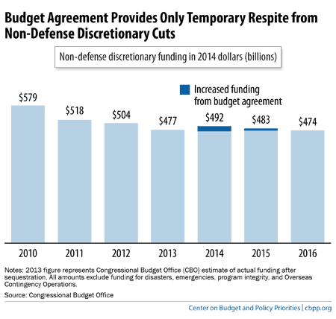

Slide 14
What is happening in congress now
Appropriations
Health Center funding cliff
National Housing Trust Fund
Increase in minimum wage

Slide 15
appropriations
FY15 starts October 1, 2014
A Continuing Resolution will likely be needed to keep gov’t funded
Housing funding is at particular risk
Health Centers likely to receive a big increase thanks to ACA funds
Things will stay tough with BCA

Slide 16
Health center funding cliff
ACA health center funds end September 30, 2015
Health centers have come to depend on ACA funds for operating grants
Could result in a 70% reduction in the federal grant
Also impacts the National Health Service Corps and Teaching Health Centers

Slide 18
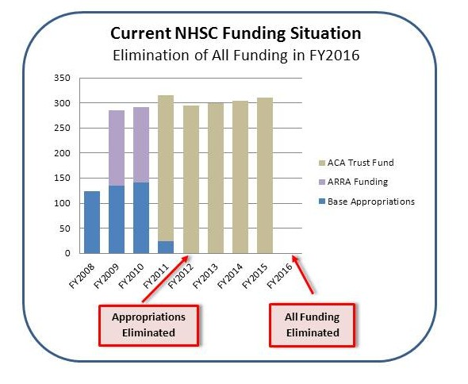

Slide 19
National housing trust fund
Created in 2008 to fund creation and operation of affordable housing
Only program targeted to extremely low-income households
Legislation introduced to fund NHTF through reforming the Mortgage Interest Deduction or through reforming Federal Housing Finance

Slide 20
Increasing minimum wage
Federal minimum wage has not been increased since 2009
Legislation to raise the minimum wage to $10.10/hour and index to inflation
Still not a living wage

Slide 21
Other federal legislative issues
Protecting Tenants at Foreclosure Act
Homeless Children and Youth Act
Helping Families in Mental Health Crisis Act
Family Health Care Accessibility Act
Immigration Reform Legislation
Voting Rights Act Amendments
2016 Budgets due in early 2015

Slide 22
Actions you can take NOW
Congressional Switchboard Phone Number: 1-877-210-5351
White House Phone Number: 202-456-1111
Sign up for the Mobilizer on the handout

Slide 23
Work with council policy team
Call into Congressional meetings with Council staff
Work to schedule a tour with Congressional reps
Work with national coalitions
Provide stories and examples of the impact of policies

Slide 24
Educate media and the public
Write letters to the editor or op-eds
Get active on social media
Support consumer involvement and community education
Develop a Speakers Bureau

Slide 25
Access is the answer campaign
Grassroots advocacy campaign to address the funding cliff
Petitions and letters of community support
House and Senate Dear Colleague Letters circulating now!

Slide 26
National HCH Council Resources
Policy briefs, webinars, advocacy materials: www.nhchc.org/policy-advocacy/
Access is the Answer campaign: www.saveourchcs.org
Dan Rabbitt, Health Policy Organizer, drabbitt@nhchc.org

