Slide 1
Taking a History of Sexual Health: Opening the Door to Effective HIV and STI Prevention August 15, 2014
Harvey J Makadon, MD
The National LGBT Health Education Center, The Fenway Institute
Harvard Medical School
Boston, MA

Slide 2
Learning Objectives
At the end of this webinar, participants should be able to:
Identify strategies for taking a history of sexual health
Access sample questions that clinicians can use in asking about sexual health with all adult patients
Discuss elements of effective HIV screening, prevention and care programs
Discuss implications of developing effective programs to work with homeless populations

Slide 3
Background Issues
What people do and want
What clinicians say

Slide 4
What Patients Want
Survey of 500 men and women over 25
85% expressed an interest in talking to their doctors about sexual concerns
71% thought their provider would likely dismiss their concerns
A history of sexual health followed by appropriate, targeted discussion can enhance the patient-provider relationship

Slide 5
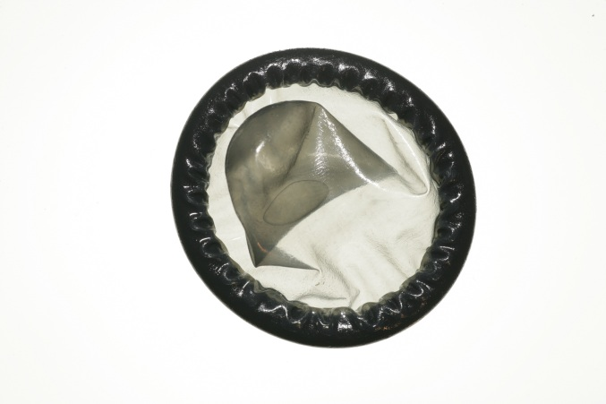
Proportion of Physicians Discussing Topics with HIV-Positive Patients
Adherence to ART | 84%
Condom use | 16%
HIV transmission and/or risk reduction | 14%
(AmJPublicHealth. 2004;94:1186-92)
Notes:
 2 minutes
➔ To illustrate providers’ performance in asking about issues associated with risk assessment.
☑ In 1991, the United State Public Health Service (Healthy People 2000) established a goal that 75% of primary care clinicians provide HIV/STD prevention counseling and risk assessments to their patients. This goal was re-emphasized in HP 2010.
In a study by Metsch et al (11/2000-06/2001), HIV care providers in 4 major American cities (Atlanta, Baltimore, Los Angeles and Miami) reported they infrequently asked about condom use, HIV transmission risk or risk reduction.
☑ Factors associated with increased counseling (Metsch 2004):
Interacting with a newly diagnosed patient
Having sufficient time with patients
Familiarity with treatment guidelines
☑ Factors associated with decreased counseling (Metsch 2004):
Patients perceived as having mental health and/or substance abuse problems
Having a disproportionate amount of male patients
Medical care delivered by infectious disease specialists
 Metsch LR, Pereyra M, del Rio C, et al. Delivery of HIV Prevention Counseling by Physicians at HIV Medical Care Settings in 4 US Cities. AmJPublicHealth. 2004;94:1186-92.




Slide 6
Discomfort as a Barrier
“Ironically, it may require greater intimacy to discuss sex than to engage in it.”
The Hidden Epidemic
Institute of Medicine, 1997
Notes:
 30 seconds
☑ This is a quote from “The Hidden Epidemic” suggeSTDng the difficult of engaging in discussions about sexual behavior. Effective dialogue requires a high degree of comfort and experience
Transition: “Yet even when providers do ask about sexual behavior, often they do not document risk factors that patients report.”
 Elford J, Bolding G, Maguire M, Sherr L. Do gay men discuss HIV risk reduction with their GP? AIDS Care. 2001;12:287-290.
 Eng TR, Butler WT eds. The Hidden Epidemic: Confronting Sexually Transmitted Diseases. Committee on Prevention and Control of Sexually Transmitted Diseases. InSTDtute of Medicine. National Academy Press, Washington, DC 1997


Slide 7
Sexual Behavior Among Massachusetts High School Students by Gender, 2009
 | Affirmative Responses
 | Males | Females
Respondents: All Students Lifetime sexual intercourse Sexual intercourse before age 13 Four or more lifetime sexual partners | 48.0% 8.0% 15.2% | 44.6% 3.0% 10.6%
Respondents: Students having sexual intercourse in past three months Condom use at last sexual intercourse Substance use at last sexual intercourse Taught in school about AIDS or HIV | 65.7% 27.6% 87.2% | 50.6% 20.0% 87.6%
Youth Risk Behavior Surveillance System, MMWR, 2010

Slide 8
When We Talk About the Elderly What Comes to Mind?

Slide 9
ELDERsexuals
Percent Having Sex
Age | Men | Women
57-64 | 84% | 62%
65-74 | 67% | 40%
75-85 | 38% | 16%
Lindau, NEJM, 2007

Slide 10
Getting to know patients in clinical settings

Slide 11
Proportion of Physicians Discussing Topics with HIV-Positive Patients
Adherence to ART | 84%
Condom use | 16%
HIV transmission and/or risk reduction | 14%
(AmJPublicHealth. 2004;94:1186-92)

Slide 12
Discomfort as a Barrier
“Ironically, it may require greater intimacy to discuss sex than to engage in it.”
The Hidden Epidemic
Institute of Medicine, 1997

Slide 13
Taking a History of Sexual Health
http://www.lgbthealtheducation.org/publications/top/briefs/sexual-history-toolkit/

Slide 14
Taking a History of Sexual Health
The core comprehensive history for LGBT patients is the same as for all patients (keeping in mind unique health risks and issues of LGBT populations)
Get to know your patient as a person (e.g., partners, children, jobs, living circumstances)
Use inclusive and neutral language
Instead of: “Do you have a wife/husband or boy/girlfriend?”
Ask: “Do you have a partner?” or “Are you in a relationship?” “What do you call your partner?”
For all patients
Make it routine
Make no assumptions
Put in context and assure confidentiality
Notes:
14

Slide 15
Taking a History of Sexual Health
Ask about behavior and risk
Have you had sex with anyone in the last year?
Did you have sex with men, women, or both?
How many partners did you have?
Ask about sexual health, sexual and gender identity
Do you have any concerns about your sexual function?
Have you had any changes in sexual desire?
How satisfied are you sexually?
Do you want to talk about your sexuality, sexual identity, or gender identity
Ask about reproductive health and desires
Traditionally, discuss contraception
Discuss desires to have children and methods- surrogacy, adoption

Slide 16
Detailed Sexual Health Assessment
The Centers for Disease Control and Prevention (CDC) has developed a simple categorization of sexual history questions to help focus on key issues.
http://www.cdc.gov/lgbthealth/

Slide 17
Partners
Have you been sexually active in the last year?
Do you have sex with men only, women only, or both?
How many people have you had sex with in the past year?

Slide 18
Practices and protection
What kinds of sex are you having? (e.g., oral, vaginal, anal, sharing sex toys)
What do you do to protect yourself from HIV and STDs?
How often do you use protection?
If sometimes, when, why and with whom?

Slide 19
Practices and protection
Do you or your partner(s) use alcohol or drugs when you have sex?
Have you or your partner(s) ever had sex in exchange for drugs, money, shelter, food, or other necessities?
Have you ever had sex with someone you didn’t know or just met?

Slide 20
History of STD’s (STI’s)
Have you ever had a sexually transmitted disease?
When, What kind?; How were you treated?
Have you ever been tested for any STD’s or HIV?
If yes, when and what were results?
Has your current, or any former, partners been diagnosed with an STD?
Were you evaluated for the same?
Were you treated and with what?

Slide 21
Pregnancy Protection and Desires
Are you trying to conceive or parent a child?
Are you concerned about getting pregnant or getting your partner pregnant?
Are you using contraception or any form of birth control?
Do you want to discuss challenges regarding having children?

Slide 22
Partner Violence, Trauma
Have you ever experienced physical or emotional violence with someone you were involved with?

Slide 23
Sexual and Gender identity, Desire, sexual Health
Assess comfort with sexual and gender identity
Do you want to talk about your sexuality, sexual identity, gender identity, or sexual desires?
Ask about sexual health
Do you have any concerns about your sexual function or satisfaction?

Slide 24
Sexual Health: Opening Doors to Effective HIV and STI Prevention

Slide 25
People, Practices, Outcomes:
Pregnant Women
STIs
MSM
HIV
WSW
Hep C
Adolescents
Trans Men
Trans Women

Slide 26
HIV/AIDS in The United States

Slide 27
HIV in the United States
Approximately 1.2 million people are living with HIV
There are ~50,000 new cases of HIV diagnosed every year
CDC, 2012
Notes:
An increase in the number of individuals living with HIV reflects the success of antiretroviral therapy, which has turned HIV from an untreatable, fatal condition into a chronic illness. However, it also means that there are more people capable of transmitting the infection to others. The number of new HIV infections each year has remained stable for at least the past several years (Prejean, 2011).

Slide 28
HIV Incidence by Transmission Category, United States, 2011
Centers for Disease Control and Prevention.
HIV Surveillance Report, 2011; vol. 23.
http://www.cdc.gov/hiv/topics/surveillance/resources/reports/.
.

Slide 29
HIV Incidence in the United States, 2008-2011
Centers for Disease Control and Prevention.
HIV Surveillance Report, 2011; vol. 23.
http://www.cdc.gov/hiv/topics/surveillance/resources/reports/.

Slide 30
Why is HIV incidence highest among black MSM?
Sexual risk behaviors and substance use do not explain the differences in HIV infection between Black and white MSM
The most likely causes of disproportionate HIV infection rates are:
Barriers to access health care
Less awareness of HIV status
Delayed treatment of STI’s which facilitate HIV transmission
High HIV prevalence in Black MSM networks especially among those who identify as gay.

Slide 31
Transgender women are also at high risk
Estimated HIV prevalence in trans women
28% in US
56% in African-Americans
18-22% worldwide
Baral, 2013; Herbst, 2008; Schulden, 2008

Slide 32
Opportunities along the HIV Continuum
Outreach
Engagement in Care
Adherence Counseling
Counseling and Testing
Case Management
Linkage to Care
Adapted from CDC, “HIV in the US-The Stages of Care” July 2012

Slide 33
The National HIV/AIDS Strategy
Goals:
Reduce the number of people who become infected with HIV
Increase access to care and optimize health outcomes for people living with HIV
Reduce HIV-related health disparities
Achieve a more coordinated national response to the HIV epidemic

Slide 34
Prevention of HIV
Universal HIV Screening
HIV Negative
Reduce HIV Incidence
HIV care / antiretroviral therapy/ Counseling/ Adherence
HIV Positive
Safer sex
Address STIs
PEP or PrEP Counseling/
Adherence
Notes:
This all must take place with attention to stigma, homophobia, and poverty.
A trial (HPTN 065) is currently underway as a proof-of-concept study for this integrated approach to HIV prevention.

Slide 35
Is he HIV Infected at Baseline?
Universal HIV Screening
HIV Negative
Reduce HIV Incidence
HIV care / antiretroviral therapy/ Counseling/ Adherence
HIV Positive
Safer sex
Address STIs
PEP or PrEP Counseling/
Adherence
Notes:
This all must take place with attention to stigma, homophobia, and poverty.
A trial (HPTN 065) is currently underway as a proof-of-concept study for this integrated approach to HIV prevention.

Slide 36
More Testing is Needed
20% of those with HIV do not know they are infected.
32% receive an AIDS diagnosis within one year of HIV diagnosis.
MMWR, 2010
Notes:
While many individuals in this country have been tested, there are still shortfalls in testing, and approximately 20% of infected individuals are not thought to be aware of their status (down from 25% in 2003). In addition, many people are diagnosed late in their illness, as shown here.
There is some good news in this regard; data recently presented at a conference indicated that, among all MSM groups, awareness of HIV infection increased from 2008 to 2011.

Slide 37
Barriers to HIV Testing
Only 61% of general internists offer HIV testing regardless of risk.
50% of EDs are aware of CDC’s guidelines, and only 56% offer HIV testing.
HHS interviewed a sample of health centers in 2011 to see if following CDC’s HIV testing guidelines:
Only 20% of sites were testing all patients 13-64 y/o
Remaining sites only tested high-risk patients or those who asked
Haukoos, 2011; Korthuis, 2011
Notes:
As only a minority of states have laws which contradict CDC recommendations, greater barriers to routine HIV testing include provider unawareness or failure to apply the recommendations. HIV testing was available in just over half of emergency departments in one study, even though EDs are used for primary medical care by many patients. In addition, many primary care providers do not offer routine HIV testing.

Slide 38
Screening and testing are prevention interventions
USPSTF Grade A Recommendation: Test all once
Those who test positive need evaluation and treatment.
People who are negative but at high risk need ongoing testing
Testing is a pre-requisite for:
Treatment as prevention
Pre-exposure prophylaxis
Weinhardt, 1999
Notes:
HIV testing has, of course, been around for a long time. The idea behind it as a preventive intervention is that, once aware of their HIV diagnosis, individuals with HIV typically reduce risky sexual behavior through which HIV can be transmitted. Diagnosis also allows treatment, which can prevent spread of infection.
Research showing a change in sexual risk behavior after HIV diagnosis mostly predates the HAART era. Now that HIV is more treatable, it is not known if behavior changes are as pronounced, but HIV counseling and testing still comprise one cornerstone of preventive efforts.

Slide 39
HIV Infected at Baseline?
Universal HIV Screening
HIV Negative
Reduce HIV Incidence
HIV care / antiretroviral therapy/ Counseling/ Adherence
HIV Positive
Safer sex
Address STIs
PEP or PrEP Counseling/
Adherence
Notes:
This all must take place with attention to stigma, homophobia, and poverty.
A trial (HPTN 065) is currently underway as a proof-of-concept study for this integrated approach to HIV prevention.

Slide 40
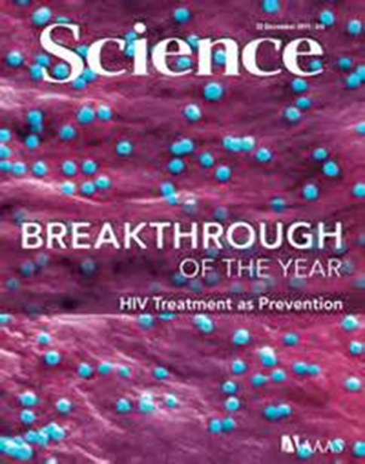
Early antiretroviral therapy decreases HIV transmission
1763 stable, healthy, serodiscordant couples, sexually active CD4 count: 350 to 550 cells/mm³
Randomization
Early antiretroviral therapy CD4 350-550
Delayed antiretroviral therapy CD4 ≤250
4 infections
35 infections
1 linked, 3 unlinked
27 linked, 8 unlinked
96% relative risk reduction in linked transmissions
Cohen, NEJM, 2011

Slide 41
Is he HIV Infected at Baseline?
Universal HIV Screening
HIV Negative
Reduce HIV Incidence
HIV care / antiretroviral therapy/ Counseling/ Adherence
HIV Positive
Safer sex
Address STIs
PEP or PrEP Counseling/
Adherence
Notes:
This all must take place with attention to stigma, homophobia, and poverty.
A trial (HPTN 065) is currently underway as a proof-of-concept study for this integrated approach to HIV prevention.

Slide 42
Post-Exposure Prophylaxis (PEP)
Indicated for high-risk exposures to HIV-infected individuals
Consists of 28 days of antiretrovirals (usually tenofovir-emtricitabine +/- others, often raltegravir)
Earlier initiation = better efficacy (likely not useful after 72 hours)
HIV testing at baseline, 1, and 3 months

Slide 43
Contribution of STD’s to HIV Transmission
Augmentation of HIV infectiousness and susceptibility via a variety of biological mechanisms from both ulcerative and non-ulcerative STD’s
Among MSM infected with rectal GC or CT, a history of 2 additional prior rectal infections was associated with an 8 fold increased risk of HIV infection.

Slide 44
Transgender Men and Women
STI/STD screening and counseling based on behavior and anatomy
Many trans women have a functional penis
Many trans men have a vagina and cervix

Slide 45
PrEP: Can a pill prevent HIV?

Slide 46
Oral PrEP IS Safe And Efficacious; Efficacy is Dependent Upon Adherence
Study | Efficacy overall | Drug detected overall | Estimated Risk reduction with drug detection
iPrEx | 42% | ~50% | 92%
Partners PrEP | 67-75% | 82% | 86% (TDF) 90% (FTC/TDF)
TDF-2 | 62% | 80% | 78%
Fem-PrEP | No efficacy | 26% | “adherence too low to assess efficacy”
VOICE | No efficacy | 29% | “ adherence too low to assess efficacy”
Thai IDU | 49% | N/A | N/A
Grant NEJM 2010, Mulligan CROI 2011, Van Damme NEJM 2012, Karim Science 2010, www.mtnstopshiv.org, Baeten NEJM 2012, Thigpen NEJM 2012, Marrazzo CROI 2013, Choopanya Lancet 2013
Notes:
Fem-PrEP: In seroconverters: 26% had drug detected at beginning of infxn window, 21% at end, 15% at both; In non-seroconverters: 25% at beginning, 37% at end, 24% at both (in comparison to 80% in non-seroconverters in TDF2 and partners PrEP)

Slide 47
CDC Guidance on Prescribing PrEP
These guidelines will help increase access to PrEP for all at-risk persons. They will also underscore the need for providers to talk with their patients about their sexual health and consider PrEP as one key option in an HIV prevention package.
Determine Eligibility (negative HIV test, at high-risk for HIV acquisition, screen/treat for STDs, screen/vaccinate for Hep B; pregnancy test)
Prescribe tenofovir-emtricitabine 1 tablet by mouth daily
Provide condoms and risk-reduction counseling
Monitor closely (at 1 month, then q 2-3 months: HIV testing, follow BUN/Cr, repeated risk assessment and counseling)
Notes:
CDC has issued and updated guidelines since the FDA approval of TDF-FTC for HIV prevention.

Slide 48
“The PrEP Package”
Notes:
The Fenway Institute has recently created two documents, one for clinicians and one for patients, which focus on PrEP.

Slide 49
Expanding the Care Continuum to Optimize Effective HIV Care in Clinical Practice
Traditional Focus
Population
Health
Peer Navigation
Primary Care
Diagnostic Testing
Urgent Care
Rehab Care
Long-term Care
Prevention
Behavioral Health
Hospital Care
Dental/ Optical
Engagement in Care
Skilled Nursing
Outreach

Slide 50
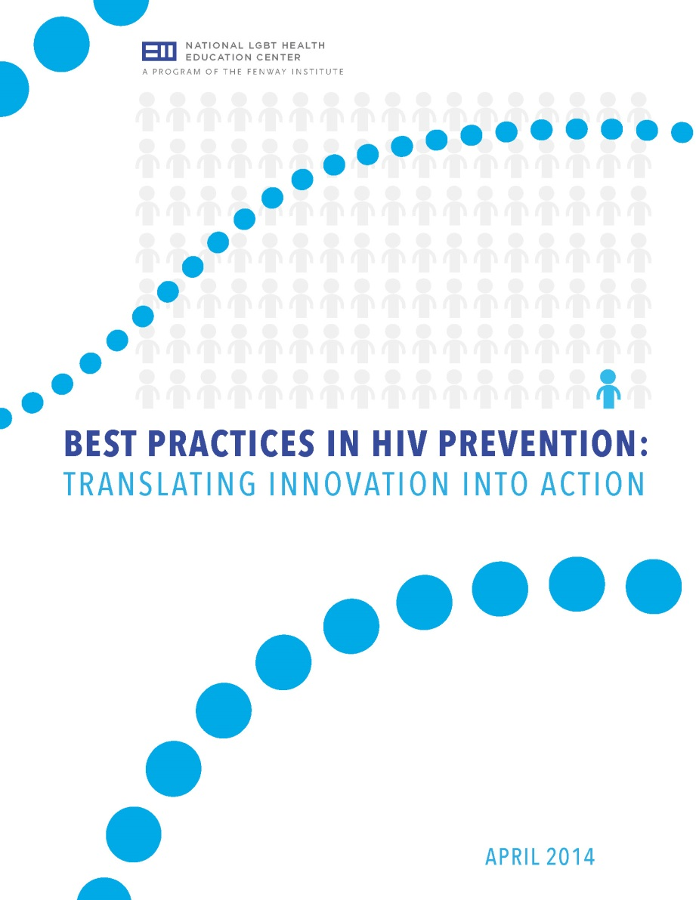
http://www.lgbthealtheducation.org/training/online-courses/BestPracticesinHIVPrevention/

Slide 51
Summary
HIV disproportionately affects MSM and transgender individuals.
HIV screening and testing is the cornerstone of most prevention interventions.
Treatment-as-prevention, PEP, and PrEP are powerful bio-behavioral tools to decrease HIV incidence.
Health centers have opportunities to create and improve HIV prevention programs.

Slide 52
Questions?

Slide 53
We are here to help you!
Adrianna Sicari, Hilary Goldhammer, Harvey Makadon
 617.927.6354
 lgbthealtheducation@fenwayhealth.org
 www.lgbthealtheducation.org

