Slide 1
Pharmacotherapies for Alcohol Use Disorder
Dai Tan
JD, PharmD (2015)
University of California, San Francisco
Petaluma Health Center
dai.tan@ucsf.edu

Slide 2
Objectives
Understand the adverse consequences of AUD
Describe the pharmacological therapy options available for treatment of AUD
Describe the non-pharmacological therapy options available for treatment of AUD
List the adjunctive treatments for AUD

Slide 3
Recommended Reading
Pharmacotherapy for Adults With Alcohol Use Disorders in Outpatient Settings: A Systematic Review and Meta-analysis
N = ~23,000, 122 Trials
Acamprosate and naltrexone help in decreasing alcohol use but are underutilized.
Jonas DE, Amick HR, Feltner C, et al.
http://jama.jamanetwork.com/article.aspx?articleid=1869208
“Drugs to Aid Alcoholics See Little Use, Study Finds”
“Less than a third of all people with alcohol problems receive treatment of any kind, and less than 10 percent are prescribed medications. The Affordable Care Act requires that insurers provide coverage for substance abuse treatments and services.”
http://www.nytimes.com/2014/05/14/health/effective-drugs-to-curb-alcoholism-are-ignored-study-finds.html

Slide 4
Patient Case
FS is a 62 yo male veteran who presents today at his PCP appointment for his alcohol use. Recent nightmares have caused him to increase his alcohol consumption. He has been drinking to the point where he blacks out and sleeps through most of the day.
He expresses concern that he will lose his current housing since he has not been paying the rent for several months due to spending his money on alcohol and gambling. He has been off his medications for the past few weeks and was recently restarted on his medications while at the ED for an alcohol related MVA.
Today FS reports interest in treatment for his alcohol use. He has tried and failed acamprosate in the past.

Slide 5
Patient Case
PMH: ACM, HTN, DVT x2, AUD, Chronic lower back pain, PTSD, HLD
FH: father alcoholic, mother bipolar d/o
SH: 2ppd x20 years, 6+ drinks/day x15 years
Vitals: BP 155/90 HR 88 Wt: 178lbs Ht: 5’9”
Current Medications
warfarin 5mg daily sertraline 200mg daily
lisinopril 40mg daily prazosin 5mg at bedtime
carvedilol 6.25mg po bid atorvastatin 40mg daily
furosemide 20mg daily
hydrocodone/APAP 325mg/5mg 1-2 tabs q4-6 hours prn pain

Slide 6
Patient Case
AST | ALT | Alk Phos | T. Bili | Protein | Albumin
151 H | 91 H | 56 | 0.9 | 7.7 | 3.6
Glucose | BUN | Creat | Na | K | Cl | CO2
85 | 7 L | 0.93 | 132 L | 4.3 | 95 L | 28.6
WBC | Hgb | Hct | MCV | Plt | Neutro
3.3 L | 15.9 | 45.3 | 92 | 155 | 1.7
TG | TC | HDL | LDL-d | INR | A1C
440 H | 320 H | 35 L | 190 H | 3.4 | 6.6
LVEF today | LVEF 1 year ago
30% | 35%

Slide 7
Epidemiology
High prevalence
WHO estimated > 75 million people had alcohol abuse or dependence worldwide over the last year
According to the 2008 National Survey on Drug Use and Health, approximately 51.6% of Americans aged ≥ 12 reported being current alcoholic drinkers
In the USA ~18 million Americans have an alcohol abuse disorder. Excessive drinking kills about 88,000 people per year.
Increased rates associated with:
Male sex, being single, lower income, white or Native American ethnicity, ages 30-64
Military combat deployment increases risk for alcohol-related problems

Slide 8
Economic & Social Costs
In 2006, alcoholism cost the United States $223 billion in lost productivity, healthcare costs, law enforcement and criminal justice costs. (Bouchery et al., 2011)
Surveys show that ~23.1 million ages 12 or older needed treatment for substance use in 2010, but only 2.6 million received treatment at a specialty facility in the prior year. (SAMHSA 2011)
For those who received treatment, the likelihood of being arrested decreased 16 percent and the likelihood of felony convictions dropped 34 percent, contributing to cost savings. (Estee & Nordlund, 2003)
A California study found that >70% of the estimated costs of alcohol abuse can be attributed to lost productivity. (Jordan et al., 2008)

Slide 9
Cost Savings due to Drug Treatment
In California substance abuse treatment has been show to have a benefit-cost ratio of 7:1 ($1,583 per patient with a cost offset of $11,487), with most savings due to lower crime and increased employment. (Ettner, et al. 2006)
Every dollar spent on substance abuse treatment saves $4 in healthcare costs and $7 in law enforcement/criminal justice costs
In one California Kaiser study, treating patients (n=1,011) reduced (Parthasarathy S, et al. 2001):
ER Visits by 39%
Hospital Stays by 35%
Total Medical Costs by 26%
2005 Omnibus Treatment of Mental Health and Substance Abuse Disorders Act (WA Senate Bill 5763)
Expanded alcohol or other drug (AOD) treatment from 2005-2009, targeted to Medicaid and GA-unemployment (Disability Lifeline)
In Washington, ROI of 2:1 in the first four years, with $2 per medical/nursing facility costs saved per $1 invested in treatment.

Slide 10
Pathophysiology
Biological
Alcohol enhances the dopamine reward pathway
Psychosocial
Low self-esteem, impulsiveness, stress and/or anxiety, depression
Environmental
Peer pressure, alcoholic parents/family member

Slide 11
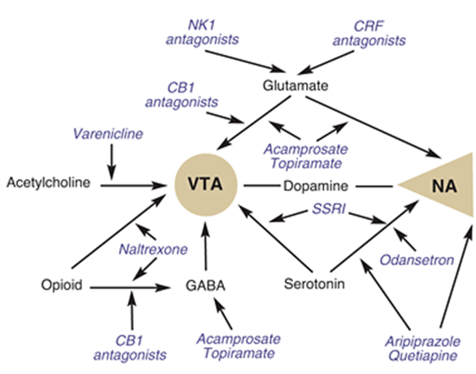
Proposed Sites of Action
Medications and their proposed sites of action on the neural pathways that mediate alcohol reinforcement.
CB1 = cannabinoid-1, CRF = corticotrophin-releasing factor, GABA = γ-aminobutyric acid,
NA = nucleus accumbens, NK1 = neurokinin 1, VTA = ventral tegmental area.
Krishnan-Sarin,S (2008).

Slide 12
Diagnosis of Alcohol Use Disorder
DSM-IV
Alcohol dependence
Alcohol abuse
DSM-5
Integrates both alcohol dependence and alcohol abuse into one disorder
A spectrum that comprises of mild, moderate, and severe sub-classifications

Slide 13
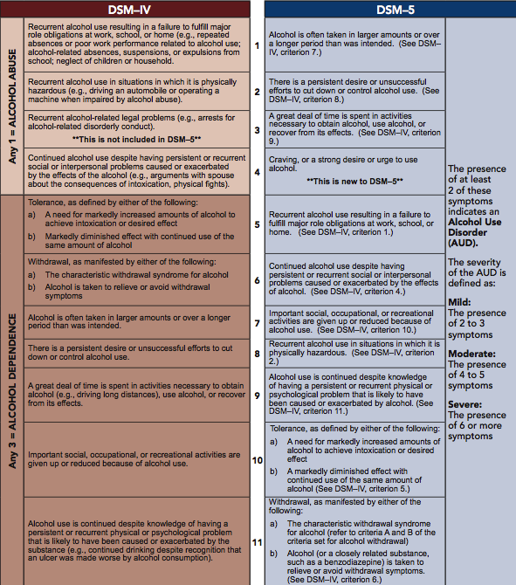

Slide 14
NIAAA Subtypes
Young adult
31% - low rates of other substance abuse and mental disorders, low rate family alcoholism
Young antisocial subtype
21% - early onset of regular drinking, ~50% family history alcoholism and diagnosis of antisocial personality disorder, 75% smoke cigarettes and marijuana, also cocaine and opiate addiction, frequent major depression, anxiety, bipolar disorder
Functional subtype
20% - middle-aged, well-educated, stable jobs/family, 1/3 family history alcoholism, 1/4 major depression, 1/2 smokers
Intermediate familial subtype
19% - middle-aged, 50% family history alcoholism, 20% bipolar disorder, most smokers
Chronic severe subtype
9%- middle-aged, early onset of drinking and alcohol problems, 80% family history alcoholism highest rates depression, anxiety, bipolar disorder, antisocial personality disorder, criminality, other substance abuse does not interfere with other things in life

Slide 15
Adverse Consequences
Medical morbidity
Hepatitis, cirrhosis, hypertension, tuberculosis, pneumonia, pancreatitis, cardiomyopathy, GI bleed
Associated with certain cancers
Mouth, esophagus, pharynx, larynx, breast
Associated with psychiatric and disorders
Depression, eating disorders, anxiety disorders
Neurologic effects
Wernicke encephalopathy, Korsakoff syndrome, cerebellar degeneration, Alcohol-Related Dementia
Fluid/electrolyte imbalance
Hypoglycemia, lactic acidosis, hyperuricemia, hypomagnesemia, hypophosphatemia, hypocalcemia

Slide 16
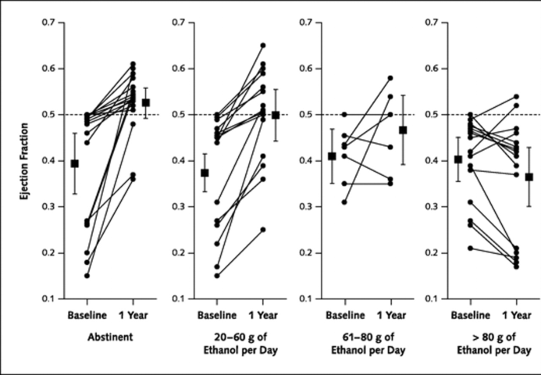
Effect of Controlled Drinking in Alcoholic Cardiomyopathy
55 alcoholic men w/ cardiomyopathy
At 1 year mark following abstinence, LVEF improved by ~0.131
At 4 years, improvement in those who were abstinent and reduced drinking to moderate levels.
Nicolas, JM, et al. Ann Intern Med 2002;136:192-200.

Slide 17
Pharmacotherapy for AUD
FDA-labeled
Naltrexone
Acamprosate
Disulfiram
Non-FDA labeled
Topiramate
Gabapentin
Baclofen
Before initiating, evaluate whether a CIWA should be used and whether acute treatment is required.
ALWAYS PAIR MEDICATIONS WITH PSYCHOTHERAPY AND SUPPORTIVE SERVICES WHEN POSSIBLE!!!

Slide 18
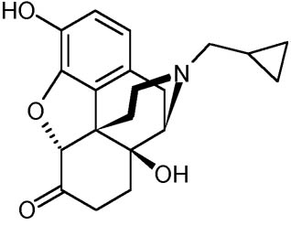
Naltrexone Reduction in Pleasure & Craving
MOA
Pure opioid antagonist (mu receptor)
Decrease strong reward caused by endorphin release with alcohol use, thus decreasing pleasurable effects.
Indicated for both Alcohol and Opioid Dependence
Commonly used in Europe (Finland)
“AHRQ Systemic Review
Trials are recent with good quality. Good evidence of reduction in: relapse and days drinking, craving and abstinence enhancement, favorable harms profile. Effect size is “moderate” and may lead to “selective extinction.”
Jonas DE, et al. JAMA. 2014;311(18):1889-1900
Meta-analyses (53 studies, n = 9140)
NNT = 20 to prevent return to ANY drinking for oral naltrexone 50mg/d
(95% CI, 11 to 500; RD, −0.05; 95% CI, −0.10 to −0.002)
NNT = 12 to prevent return to HEAVY drinking on 50mg/d
(95% CI, 11 to 500; RD, −0.05; 95% CI, −0.10 to −0.002)

Slide 19
Naltrexone
Dose
Initial and maintenance
50 mg PO daily
Alternatively 50mg QD and 100mg Saturday; or 100mg QoD; or 150mg Q3days
Depot naltrexone - Vivitrol
380 mg IM every 4 weeks
Opiate Abuse: Similar to alcohol, but begin 25mg
Dosing adjustments
No adjustments necessary in renal or hepatic impairment
Use with caution since AUC can increase in hepatic cirrhosis and primary metabolite is predominately excreted in urine
Contraindications
Concomitant opioids
Acute hepatitis or liver failure
Physiologic opioid dependence with use within past 7 days

Slide 20
Naltrexone
Baseline evaluations
Opioid free ≥ 7-10 days
LFTs
Bilirubin
Urine beta-HCG for females (not pregnant)
Clinical pearls
⬇ drinking
⬆ abstinence
May be preferred if goal is reduction in heavy drinking rather than abstinence
May cause apathy with chronic treatment (chronic reduction in normal reward pathways)
Sinclair Method
Use 50mg as needed, 30-min to 1-hour BEFORE alcohol use

Slide 21
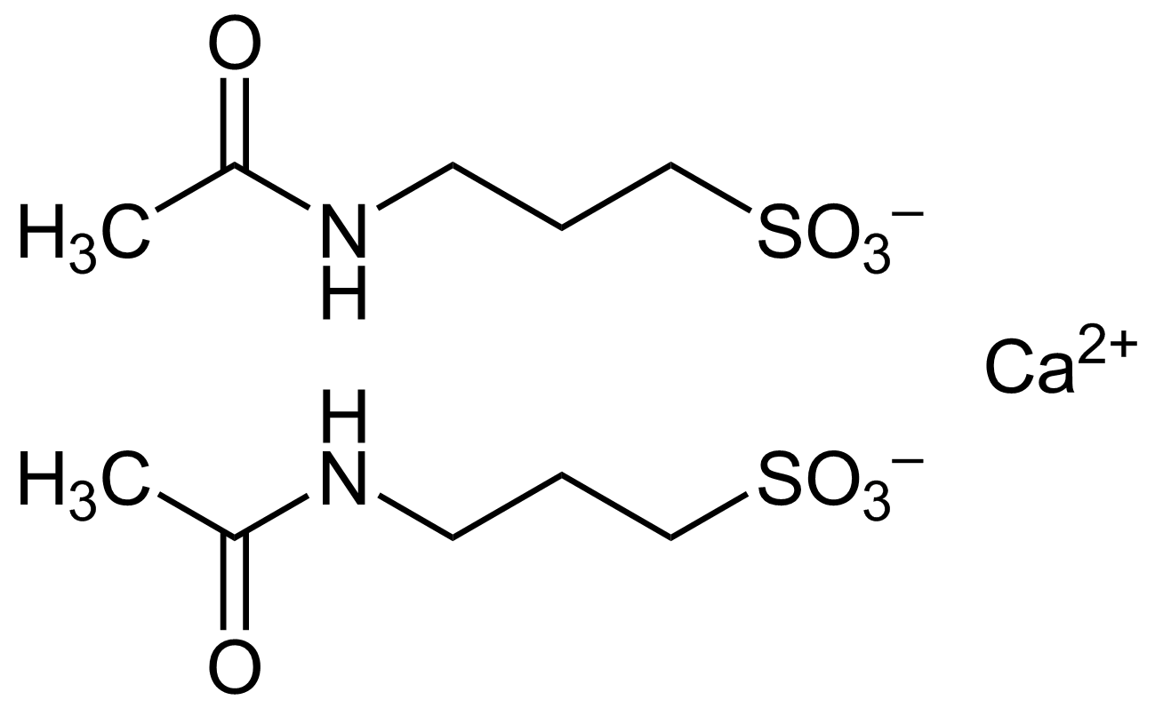
Acamprosate Reduction in Unpleasant Effects of Abstinence
MOA
Reduces excitatory glutamatergic NMDA receptors and increasing inhibitory GABA(A) receptors – reversing imbalance caused by alcoholism
Alcohol withdrawal can lead to excessive glutamate activity and deficient GABA activity; acamprosate can act as an “artificial alcohol” to mitigate these effects.
Decreases dopamine hyperexcitability in the NA during alcohol withdrawal
Cochrane Collaboration & AHRQ Conclusions
Good evidence from European data (US data mixed, likely due to greater heterogenity).
Good evidence of abstinence enhancement and reduction in drinking days, minimal evidence of reduction in craving or rates of relapse, and good evidence it is well-tolerated without serious harm. Effect size seems “rather moderate.”
Jonas DE, et al. JAMA. 2014;311(18):1889-1900
Meta-analyses (27 studies, n = 7519)
NNT = 12 to prevent a return to ANY drinking
(95% CI, 8 to 26; risk difference [RD], −0.09; 95% CI, −0.14 to −0.04)

Slide 22
Acamprosate
Dose
Initial and maintenance
666 mg PO three times daily (two 333mg tablets TID)
Dosing adjustments
CrCl 30-50 mL/min
333 mg PO three times daily
CrCl < 30 mL/min
Contraindicated in severe renal impairment
Contraindications
Severe renal impairment (CrCl <30 mL/min)

Slide 23
Acamprosate
Baseline evaluations
CrCl
Urine beta-HCG for females
ADEs
Minor: HA, diarrhea, nausea
Serious: acute renal failure
May cause depression
Clinical pearls
5-8 days to reach full effect
May be better for patients who were chronic daily drinkers rather than binge drinkers
Success may be improved by psychotherapy and:
Abstinence reached prior to initiation
Patient’s goal is abstinence

Slide 24
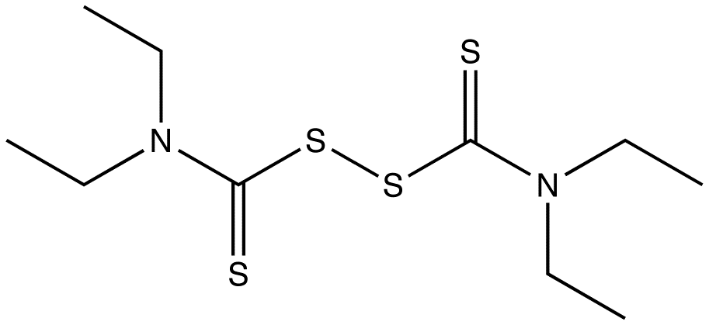
Disulfiram Avoidance Therapy
MOA
Inhibits aldehyde dehydrogenase, increasing acetaldehyde levels (leading to the “Asian glow”)
AHRQ Systemic Review
Overall, evidence from controlled clinical trials are mixed.
“There is little evidence that disulfiram enhances abstinence, but there is evidence that disulfiram reduces drinking days. When measured, compliance is a strong predictor of outcome.”

Slide 25
Disulfiram
Dose
Initial
500 mg PO daily for 1-2 weeks
Average maintenance dose
250 mg daily (range of 125-500mg)
Max dose
500 mg/day
Dosing adjustments
No dosage adjustment provided in renal or hepatic impairment
Use with caution in chronic and acute nephritis and hepatic cirrhosis or insufficiency
Contraindications
Severe myocardial disease or coronary occlusion
Use of EtOH containing products within 14 days of use
Concomitant or recent use of metronidazole (maybe)
Psychoses

Slide 26
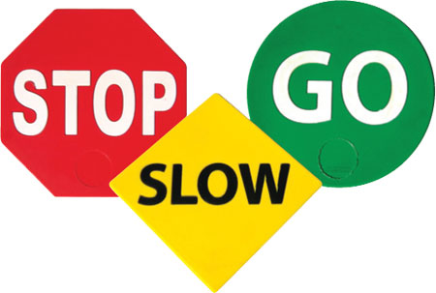
Disulfiram
AVOID
ALL ALCOHOL products, even perfumes, aftershaves, mouthwashes, etc - beware of “hidden alcohol”
Must abstain from alcohol for at least 12 hours
NEVER given during alcohol intoxication
Duration up to 14 days
Caution: diabetes, hepatic disease, hypothyroidism, nephritis, seizures
Causes extreme alcoholic hangover effects
Typical Reactions: Flushing, rash, nausea, throbbing headache, thirst, palpitations, chest pain, vertigo, hypotension
Extreme Reactions: Dyspepsia, nausea, anorexia, discolored urine, jaundice, weakness, rash and shock
Severe Reactions: respiratory depression, cardiovascular collapse, arrthymia, MI, acute CHF, seizure, unconsciousness, death.

Slide 27
Disulfiram
Baseline evaluations
Must be EtOH free ≥12 hours
LFTs
CBC
Serum chemistries
Urine beta-HCG for females
Clinical pearls
More effective for patients with a goal of abstinence.
May consider using in combination with naltrexone for augmentation.
Supervised administration may be predictive of efficacy.

Slide 28
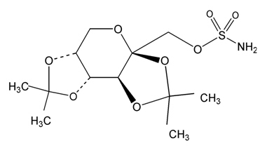
Topiramate
MOA
Blocks neuronal voltage-dependent Na+ channels, enhances GABA(A) activity
Antagonizes AMPA/kainate glutamate receptors, weakly inhibits carbonic anhydrase
Johnson et al. Arch Intern Med. 2008; 168:1188-99.
14-week multi-site RCT (n=371)
Use as adherence enhancement; Improved compulsions, psychosocial well being, weight, LFTs, cholesterol, BP
Reduction in % heavy drinking days (8.44% mean difference; 95% CI, 3.07–13.80%; P = 0.002)
Jonas DE, et al. JAMA. 2014;311(18):1889-1900
Weighted Mean Difference
% heavy drinking days: WMD, −9.0%; 95% CI, −15.3% to −2.7%
Drinks per drinking day: WMD, −1.0; 95% CI, −1.6 to −0.48

Slide 29
Topiramate
Dose
Initial
25 mg PO daily
Maintenance
Titrate dose by 25-50 mg weekly to a maximum of 150 mg twice daily
Dosing adjustments
CrCl < 70 mL/min
Give 50% of dose and use slower titration
Hepatic impairment
No dosing adjustments necessary
Use cautiously because clearance may be reduced
Contraindications
None for immediate release formulation
Extended release is contraindicated with concomitant EtOH use or recent EtOH use (i.e., within 6 hours prior to & 6 hours after administration) – space from drinks

Slide 30
Topiramate
Baseline evaluations
Weight
CrCl
Serum bicarbonate
Urine beta-HCG for females
Common ADEs
Paresthesias, changes in taste, anorexia
“Dumbing down” - impaired concentration, memory and speech
Clinical pearls
⬇ drinking
⬆ abstinence

Slide 31
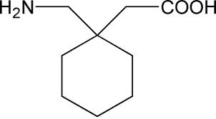
Gabapentin
MOA
Structurally similar to GABA (A) or GABA(B) receptors and does not influence the uptake or degradation of GABA. Binds to high affinity gabapentin binding sites throughout the brain
Barbara J. Mason. Gabapentin Treatment for Alcohol Dependence. JAMA Intern Med. 2014 Jan;174(1):70-7.
Gabapentin significantly improved the rates of abstinence and no heavy drinking in 150 abstinent patients with alcohol dependence.
Placebo Group
Abstinence Rate: 4.1% (95% CI, 1.1%-13.7%)
No Heavy Drinking: 22.5% (95% CI, 13.6%-37.2%)
900mg Group
Abstinence Rate: 11.1% (95% CI, 5.2%-22.2%)
No Heavy Drinking: 29.6% (95% CI, 19.1%-42.8%)
1800mg Group
Abstinence Rate: 17.0% (95% CI, 8.9%-30.1%), NNT = 8
No Heavy Drinking: 44.7% (95% CI, 31.4%-58.8%)

Slide 32
Gabapentin
Dose
Initial
300 mg PO at bedtime
Maintenance
Titrate dose by 300 mg/day to target of 600-1800 mg, given in divided doses
Dosing adjustments
CrCl >15-29 mL/min
200-700 mg PO at bedtime
CrCl = 15 mL/min
100-300 mg PO at bedtime
CrCl < 15 mL/min
Reduce dose in proportion to CrCl
Post-hemodialysis
Give supplemental dose
Contraindications
Hypersensitivity to gabapentin

Slide 33
Gabapentin
Baseline evaluation
CrCl
Urine beta-HCG for females
Clinical pearls
May be effective alone or in combination with naltrexone at:
⬇ drinking, ⬇ cravings,⬇ insomnia, ⬇ anxiety
⬆ abstinence
Recent studies on use at higher doses for mild to moderate acute alcoholic intoxication and withdrawal.

Slide 34
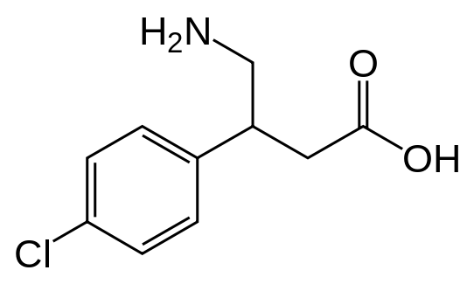
Baclofen
MOA
Centrally acting presynaptic GABA(B) receptor agonist (inhibitory)
Modulated g-protein coupled rectifying potassium channels to suppress cortico-mesolimbic dopamine neurons
Many small studies throughout the years support use in decreasing use and motivation to drink.
Recent increased interest, particularly in Europe (France)
Most evidence comes from three small RCTs at 30mg/day: 2 showed positive results, 1 showed
A 4-week trial (n=39) comparing 30mg/day to placebo found higher abstinence rates (70% to 21%).
12-week trial patients (n=84) with alcoholic liver cirrhosis, showed a two-fold rate of abstinence compared to placebo (71 versus 29 percent; OR = 6.3, 95% CI 2.4-16.1). Cumulative duration of abstinence was greater with baclofen (63 versus 31 days).
12-week placebo controlled RCT (n=80) showed no significant effect on primary or secondary endpoints, but a decrease in anxiety in the baclofen group

Slide 35
Baclofen
Dose
Initial
5 mg PO three times daily
Maintenance
10-20 mg PO three times daily
Dosing adjustments
Renal impairment
Use with caution, dose reduction may be necessary since baclofen is primarily renally eliminated
Hepatic impairment
No dose reductions is required
Contraindications
Hypersensitivity, seizure disorders (careful)

Slide 36
Baclofen
Baseline evaluation
Urine beta-HCG for females
Clinical pearls
Although most studies looked at 30mg/day, one study showed 60mg/day may be more effective.
53% reduction in # drinks per day in 10mg TID group vs. 68% for 20mg TID group (both p<0.0001, n=14 in placebo, 14 in 30mg, 14 in 60mg)
Relatively cheap compared to other medications.
Can be used in patients with cirrhosis or liver impairment and may be effective at:
⬇ drinking, ⬇ cravings
⬆ abstinence
Effective for patients with muscle spasms and spinal cord injury
Black Box: Avoid abrupt discontinuation due to risk of withdrawal

Slide 37
Cost of Treatment Options
 | Acamprosate | Naltrexone | Disulfiram | Topiramate | Gabapentin | Baclofen
State Medi-Cal | TAR | TAR | yes | yes | yes | yes
PHP | State TAR | State TAR | Tier 1 | Tier 1 | Tier 2 | Tier 1
Walmart | ~$190 | ~$40 | ~$180 | ~$8 | ~$14 | $4
Target | ~$180 | ~$50 | ~$190 | ~$20 | ~$14 | $4
CVS | ~$90 | ~$50 | ~$90 | ~$6 | ~$17 | ~$10
Walgreens | ~$100 | ~$50 | ~$100 | ~$20 | ~$15 | ~$10
PHC | no | no | no | yes | yes | $4
*Partnership Health Plan does not cover Acamprosate or Naltrexone, which are subject to a State Carve-Out. Both require TARs to State Medi-Cal, and may require an initial trial of disulfiram unless contraindicated.
** Chain pharmacy pricing from GoodRx, requiring online coupon

Slide 38
Patient Case - Continued
Which option is appropriate for this patient?
Naltrexone? No since on opiate
Acamprosate? Tried in past, but should review whether he was adherent and consider re-trial. However he may think it doesn’t work.
Disulfiram?
What other treatments should be considered?
Gabapentin – can cause edema, he has ACM so may worsen edema.

Slide 39
Non-pharmacological therapy for AUD
Cognitive behavioral therapy
Structured goal-directed form of psychotherapy where patients learn about how their own thought processes contribute to their behavior
Therapeutic communities
Residential care for individuals with moderate to severe substance use disorder
Highly structured program that provide comprehensive addiction treatment
Peer support groups
Emphasize working toward abstinence through group sharing and support
Alcoholics Anonymous
12–step programs and other models are available

Slide 40
Adjunct Treatment
Supplements for vitamin deficiency
Thiamine 100mg daily
Folic acid 1mg daily
MVI with minerals 1 tab daily

Slide 41
Misc
BDZ Note: Benzodiazepines such as chlordiazepoxide/Librium© are indicated for acute withdrawal, and should not be used for chronic treatment without a separate indication. In the setting of hepatic dysfunction, chlordiazepoxide may accumulate.
Patients rarely die of BZD overdose alone, the danger is in multiple drug combinations.
Benzos in Hepatic Dysfunction: OTL aka Oxazepam, Temazepam, Lorazepam
Others
Beta-blockers, clonidine
Haldol for hallucinations/agitation?
Propofol for refractory cases
Phenytoin not indicated for alcohol seizures
Flumazenil contraindicated

Slide 42
References
Addolorato G, et al. Baclofen Efficacy in reducing alcohol craving and intake a preliminary double-blind randomized controlled study: Alcohol & Alcoholism Vol 37. No. 5. Pp504-508, 2002
Addolorato G, et al. Dose-response effect of baclofen in reducing daily alcohol intake in alcohol dependence: secondary analysis of a randomized, double-blind, placebo-controlled trial. Alcohol Alcohol. 2011 May-Jun;46(3):312-7. doi: 10.1093/alcalc/agr017. Epub 2011 Mar 17.
Bouchery EE, Harwood HJ, Sacks JJ, Simon CJ, Brewer RD. Economic costs of excessive alcohol consumption in the U.S., 2006. Am J Prev Med. 2011 Nov;41(5):516-24.
Estee S, Norlund D. Washington State Supplemental Security Income (SSI) Cost Offset Pilot Project: 2002 Progress Report. R.a.D.A. Division and W.S.Do.S.a.H. Services, Washington State. Published February 2003. Accessed June 21, 2014.
Ettner S, Huang D, Evans E, et al. Benefit-Cost in the California Treatment Outcome Project: Does Substance Abuse Treatment “Pay for Itself”? Health Services Research. 41(1): 192–213. doi: 10.1111/j.1475-6773.2005.00466.x
Fiellin DA, Reid MC, O'Connor PG. Institute of Medicine. Improving the Quality of Health Care for Mental and Substance-Use Conditions: Quality Chasm Series, National Academy Press 2006. New therapies for alcohol problems: application to primary care. Am J Med. 2000;108(3):227.
Florez, Gerardo et al. Using Topiramate or Naltrexone for the Treatment of Alcohol-Dependent patients: Alcoholism: Clinical and Experimental Research Vol. 32, No. 7 July 2008.
Garbutt, JC, et al. Efficacy and Safety of Baclofen for Alcohol Dependence: A randomized, Double-Blind, Placebo-Controlled Trial: Alcoholism: Clinical and Experimental Research Vol. 34 No 11, November 2010
Garbutt JC, West SL, Carey TS, et al. Pharmacological treatment of alcohol dependence: a review of the evidence. JAMA 1999 Apr 14;281(14):1318-25.
Mason BJ. Gabapentin Treatment for Alcohol Dependence. JAMA Intern Med. 2014 Jan;174(1):70-7.
Jonas DE, Amick HR, Feltner C, et al. Pharmacotherapy for Adults With Alcohol Use Disorders in Outpatient Settings: A Systematic Review and Meta-analysis. JAMA. 2014;311(18):1889-1900.
Johnson, Bankole A. et al. Topiramate for Treating Alcohol Dependence: American Medical Association. JAMA October 10, 2007 Vol 298 No. 14

Slide 43
References
Jordan N, Grissom G, Alonzo G, Dietzen L, Sangsland S. Economic benefit of chemical dependency treatment to employers. J Subst Abuse Treat. 2008 Apr;34(3):311-9. Epub 2007 Jul 5.
Lexi-Comp Online. Lexi-Comp, Inc. Hudson, OH. Available at: http://online.lexi.com/crlonline. Accessed April 16, 2014.
Heinala P, Alho H, Kiianmaa K, et al. Targeted Use of Naltrexone Without Prior Detoxification in the Treatment of Alcohol Dependence: A Factorial Double-Blind, Placebo-Controlled Trial. J Clin Psychopharmacol. 2001 Jun;21(3):287-92.
Hasin DS, Stinson FS, Ogburn E, Grant BF. Prevalence, correlates, disability, and comorbidity of DSM-IV alcohol abuse and dependence in the United States: results from the National Epidemiologic Survey on Alcohol and Related Conditions. Arch Gen Psychiatry. 2007 Jul;64(7):830-42.
Jacobson IG, Ryan MA, Hooper TI, et al. Alcohol use and alcohol-related problems before and after military combat deployment. JAMA. 2008 Aug 13;300(6):663-75.
Mancuso D, Felver BEM. Washington State Department of Social and Health Services. Bending the Health Care Cost Curve by Expanding Alcohol/Drug Treatment. RDA Report 4.81. http://www.dshs.wa.gov/pdf/ms/rda/research/4/81.pdf. Published September 2010. Accessed June 20, 2014.
National Institute on Alcohol Abuse and Alcoholism. NIH Publication No. 13–7999. November 2013. www.niaaa.nih.gov
Parthasarathy S, Weisner C, Hu TW, Moore C. Association of outpatient alcohol and drug treatment utilization and cost: revisiting the offset hypothesis. J Stud Alcohol. 2001 Jan;62(1):89-97.
Ray LA, Chin PF, Miotto K. Naltrexone for the treatment of alcoholism: clinical findings, mechanisms of action, and pharmacogenetics. CNS Neurol Disord Drug Targets. 2010 Mar;9(1):13-22.
Substance Abuse and Mental Health Services Administration, Results from the 2010 National Survey on Drug Use and Health: Summary of National Findings, NSDUH Series H-41, HHS Publication No. (SMA) 11-4658. Rockville, MD, 2011.
Stahl SM. Stah’ls Essential Psychopharmacology: The Prescriber’s Guide. Cambridge: Cambridge University Press, 2011.
Substance Abuse and Mental Health Services Administration. 2009. Results from the 2008 National Survey on Drug Use and Health: National Findings (Office of Applied Studies, Substance NSDUH Series H-36, HHS Publication No. SMA 09-4434). Rockville, MD.

