Slide 1
The Business of
Recuperative Care
Presented by
Paul Leon, CEO
Illumination Foundation

Slide 2
The Product

Slide 3
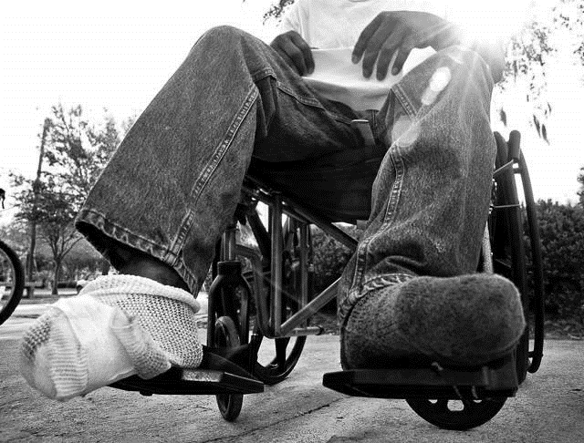
What is Recuperative Care?
Recuperative Care (aka Medical Respite) provides care to homeless persons recovering from an acute illness or injury, who are no longer in need of hospital level care but are unable to sustain recovery if living on the street or other unsuitable places.

Slide 4
Why Recuperative Care?

Slide 5
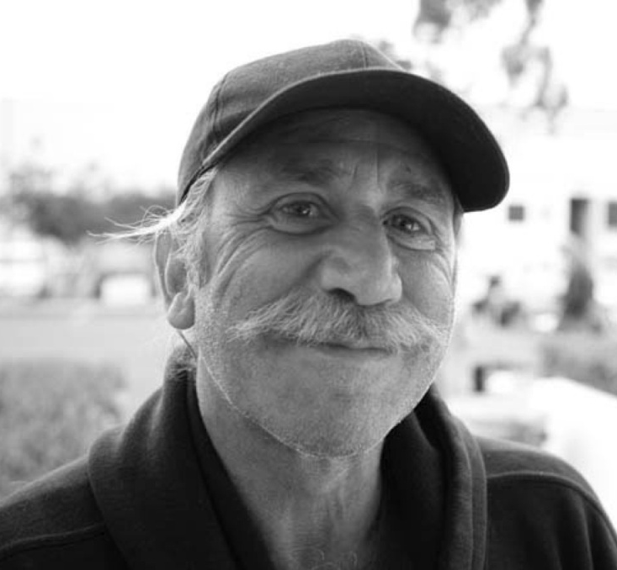
Coordination of Services
Mental Health Counseling
Medical Care
Coordination
Job readiness education
Case Management
Permanent Housing with rental assistance
Budgeting education
Goals-centered program
Savings Program 30% goal

Slide 6
IF Pioneered Recuperative Care in 2008
Los Angeles & San Gabriel Recup
Opened October 2010 / Sept 2013
Location Mid City / La Puente
Served: 24/16 Hospitals, 955 clients
Orange County Recup
Opened January 2008
Location: Buena Park
Served: 23 Hospitals, 863 Clients

Slide 7
Good Outcomes
Clients
1818 Total
Medically stabilized
Connected to social services
44% Stable housing connections
Hospitals
63
$14 million saved
Reduced inpatient stay
Reduced recidivism
Bridge the gap
in existing services
for the most
underserved to break
or prevent the cycle of homelessness
Recognitions & Innovations
AHRQ Innovations Profile
James Irvine Leadership Award
Chronic Care Plus

Slide 8
The Pitch

Slide 9
What hospitals want to hear….

Slide 10
PTD Estimated Cost Savings : 2010- Q4 2013
Estimated
Savings
Potential
Costs*
Actual Costs**
* Potential Costs is based on patients staying on average 4 days longer than
necessary in hospital
** Average hospital adjusted expenses per inpatient stay is $2,676
(American Hospital Association 2010 Annual survey)
NHF Recuperative Care data base, Kaiser Foundation State Health Facts 2008

Slide 11
Business Case Recuperative Care
 | Number of Homeless Admissions | Average Length of Stay (ALOS) | Total days of Inpatient Stay | Cost per day | Total Cost
OC Hospitals | 863 | 7.1 days (including 4 Avoidable) | 3452 Avoidable days | $2,676* | $9,237,552
Recuperative Care** | 863 | 12 | 10,356 | $250 | $2,589,000
Clearly state your company’s long term mission. Try to use words that will help direct the growth of your company, but be as concise as possible.
Potential Cost Savings $6,648,552
Assumptions:
Homeless inpatients stay an additional 4 extra days at an average cost of $2676/day
$250 Recup daily costs does not include Home Health
Sources:
*AHA 2010 Annual Survey *** Illumination Foundation Recup / NHF database

Slide 12
What hospital want to see…

Slide 13
Other Considerations….

Slide 14
Seal the Deal

Slide 15
MOUs….

Slide 16
Be clear and specific : Program Overview
Referral Services Reporting Invoicing
Easy intake process for hospital
One-page referral for hospital
2 hour turnaround referral process
Hospital determines Length of Stay (LOS)
Hospital responsible for full d/c medications for entire Length of Stay
Hospital is responsible for transportation to program site upon d/c
Monday - Sunday 9-6
Coordination of services
Medical oversight of client d/c care plan
Medical Case Management
Easy access to Medical Home
Case Management
Room and Board
Mental Health counseling
Client education and training
Transportation
Patient Outcome Reports
Hospital receives notification of client status upon intake, exit and any absences
Hospital receives for every client a Mid-LOS progress report and upon exit a Patient Outcome Summary
Extension requests are accompanied by supporting documentation to substantiate need
Simple billing process
3 Tiered per diem rate
$200 Day1-10
$150 Day 11-30
$100 Day 31+
End of month invoicing
A/P Net 30 days
Clearly state your company’s long term mission. Try to use words that will help direct the growth of your company, but be as concise as possible.

Slide 17
Customer Relations

Slide 18
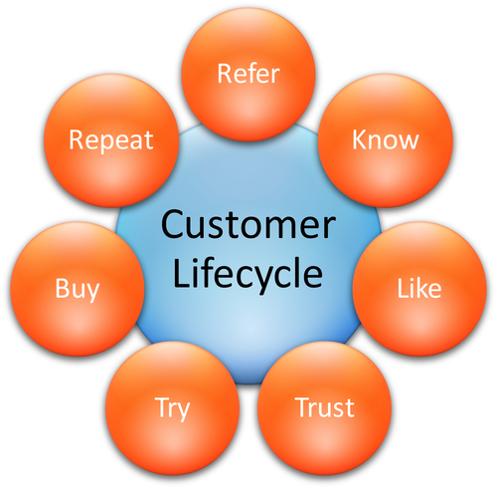
Know your customers…… and how they think
Referral Source : Hospital, MCO, SNF, County Agencies
Landlords
Clients
Partnering agencies (HH)
Housing

Slide 19
Keeping your customers…
Housing
Talk is better than email
ALWAYS be professional
Service with a Smile
Listen more; talk less
In Service Trainings quarterly
Surveys
Brainstorming sessions
Enact good practices
Conferences
In Service Trainings quarterly
Community forums
Become a SME!

Slide 20
Create a buzz…
Housing

Slide 21
Reinvention

Slide 22
We needed to do better…
Housing
Med Ins PCP MH SA CM $ JRT
Hospitalization Stabilization

Slide 23
Why? ….

Slide 24
The cost of homelessness in LA 2012 : FUSE 10th Decile
Getting Home : Outcomes from Housing High Cost Homeless Hospital Patients 2013, CSH

Slide 25
The Product

Slide 26
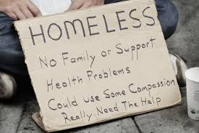
What is Chronic Care Plus?
What is Chronic Care Plus?
Chronic Care PLUS* is a collaborative two year pilot project between St. Joseph Hospital and Illumination Foundation to develop a new system of care to better meet the healthcare needs of chronically ill homeless persons who frequently use hospital emergency department care.
This new model utilizes the full resources of a world class hospital to provide the emergency, critical care, then through careful discharge planning transition the chronically ill homeless patients to Illumination Foundation for immediate, safe and restful accommodation to recuperate from their illness.
From here a comprehensive enabling social services are provided to address the many complex health and social needs of the patients, and ultimately they are provided with permanent housing to carry on an independent life free from the degradation of life on the streets.

Slide 27
Improved Outcomes

Slide 28
Future plans
Your ability to secure an expedited path to mental health services and to adapt in response to greater than predicated client acuity levels and treatment resistance is laudable. The following statement resonated strongly with our work around systems change in health care: “Each medical specialty has its own individual practice: each governmental agency has its own narrow scope of responsibility; each outside social service agency also has its own field of excellence.” We are looking to this project as a potential model for systems integration and collaboration in service of the most vulnerable and most difficult to help.
Senior Program Officer
UniHealth Foundation

Slide 29
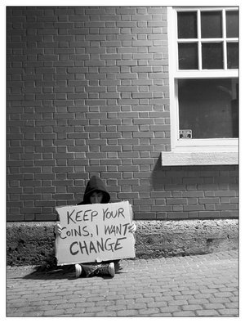
Change…. it’s in your hands
Hospital Inpatient
$2676/day
Recuperative Care
$200/day
Breaking the cycle of homelessness
Priceless

Slide 30
www.ifhomeless.org

