Slide 1
Diagnosis and Treatment of Hepatitis C in the Homeless Population
Dr. Joanna Eveland, MS, MD
Clinical Chief for Special Populations, MNHC
Notes:
I oversee hiv services and MNRC, a satellite based at a homeless drop in center. Glad to be here during this Exciting time for hep c. What has been one of the leading killers of my patients will now be curable.

Slide 2
Objectives
Understand recommendations for age cohort and risk based screening for Hepatitis C
Review strategies for health promotion and optimizing treatment readiness for HCV infected homeless individuals
Increase awareness of recent advances in Hepatitis C care and emerging opportunities for community-based treatment

Slide 3
Case Study
Ronald is a 65 year old Caucasian man who drops in to your clinic to begin primary care. He reports a history of Diabetes for which he takes oral medications. He says he used to drink heavily but has been sober for 10 years. He denies IDU. He currently lives part time in his car in San Francisco and part time with his girlfriend in Clearlake, CA.

Slide 4
Case Study
You draw routine screening blood tests for Ronald, including Liver Function Tests, CBC and Hepatitis C Antibody
Labs
Hepatitis C Antibody Positive
T.bili 1.5
AST/ALT 55/45
Albumin 3.0
Hg/HCT 15.7/46.5
Platelets 116

Slide 5
Case Study
When Ronald comes in to discuss his test results, he tells you “oh yeah, I remember they told me about the Hep C when I was in prison, but they told me everything was ok.” He then shows you several tattoos he got while in prison. He tells you “I don’t want that Interferon treatment, it almost killed my friend when he tried it.”

Slide 6
Slide credit: M. Beiser, BHCHP
Notes:
Lets back up a little bit. Hep C is a virus that can cause chronic infection in the liver. The immune system reacting to the hep c starts forming scar tissue. In some people, esp those with other RFs, this becomes cirrhosis- scarring changes blood flow to the liver and interferes with function (making proteins, clearing toxins). W cirrhosis, 3-5% chance/yr of HCC

Slide 7
How Common is Hepatitis C?
1.0% US prevalence (Denniston, 2014)
~3.2 million Americans (CDC)
22-52% across Health Care for the Homeless Programs in the US (Strehlow, 2012)
12-35% in incarcerated populations (Weinbaum, 2003)
Slide credit: M. Beiser, BHCHP
Notes:
Compared to 0.6% for HIV. Based on **NHANES which underreports persons who are incarcerated and homeless. Perhaps up to 5 million.

Slide 8
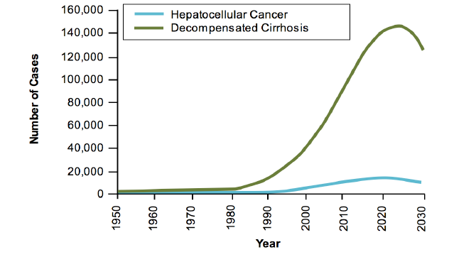
Scope of Problem in Homeless
Hepatitis C (HCV)- High prevalence,
communicable chronic illness
▫ 1.0% US prevalence NHANES Survey (Denniston et al, 2014)
~2.2-3.2 million Americans
**NHANES underreports persons who are incarcerated
and homeless
▫ 23% at BHCHP(Bharel et al, 2013)
▫ 22-52% across Health Care for the Homeless
Programs in the US (Strehlow et al, 2012)
▫ 12-35% in incarcerated populations (Weinbaum et al,
2003)
Slide credit: M. Beiser, BHCHP
Notes:
As the largest # people infected in the 60s-70s, HCV takes 20-30 yrs to cause cirrhosis, only now beginning to see the effects. Many of these people are undiagnosed, p/w cirrhosis. Hopefully will see a change in this curve with improvements to testing and treatment.

Slide 9
Hepatitis C Care Cascade
Source: Holmberg et al, 2013
Notes:
We talk a lot in HIV care about the care cascade/continuum. Now thinking about Hep C this way as well. Large # undx. Only 5% treated- part of why costs have been low- not that treatment was cheap, we didn’t treat anyone. Likely lower among homeless as most were interferon ineligible due to mental health, subs abuse.

Slide 10
Screening
The US Preventative Services Task Force recommends
Screening for hepatitis C virus (HCV) infection in persons at high risk for infection
1-time screening for HCV infection to all adults born between 1945 and 1965
Source: USPSTF, 2013
Notes:
2013 US Preventative Services Task Force (which is quite conservative), recommended risk based and birth cohort screening

Slide 11
Rationale for Birth Cohort Screening: US HCV Prevalence by Birth Year
Source: CDC MMWR August 17, 2012 / 61(RR04);1-18
Notes:
And this is the rationale for birth cohort screening- 2 large national surveys show a spike for baby boomers. Many of these individuals don’t disclose traditional RFs so haven’t previously been screened.

Slide 12
Risk Factors
Injection drug use (60% of new HCV infections occur in persons who report injection drug use within the past 6 months)
Blood product recipients
clotting factor before 1987
blood transfusion or organ transplant before 1992
Hemodialysis
Unregulated tattoo
Intranasal drug use
Incarceration
HIV infection
High risk sexual behavior
Signs or symptoms of liver disease
Source: USPSTF, 2013
Notes:
No recommended frequency by USPTF. For some of these groups, one time screening is appropriate. In my HIV program we screen annually. For active IDUs, q 6 months may be appropriate. Don’t forget HCV as part of w/u for abnormal LFTs-we’ve had elderly Central American women who were given dx of fatty liver but then found to be Hep C+- for some immigrant groups the blood supply in their home country wasn’t screened until later, also clusters in the middle east, india, amazon basin of epidemics caused by vax campaigns with dirty needles.

Slide 13
Case Study
You do further evaluation for Ronald with labs and imaging studies and find the following:
Labs
Hepatitis C Viral Load 1500000
Hepatitis C Genotype 1a
Hep A Ab+, Hep B SAg- and SAb+
HIV negative
Ultrasound shows cirrhotic appearing liver, no lesions
Upper endoscopy negative for esophageal varices
Notes:
VL is confirmatory test for chronic HCV infection- 25% will clear
Genotype- different than HIV genotype, strain of HCV-1 most common in US, still important for choosing treatment, may not be in the future
Hep A/B immune- vaccination is one of most important steps
US doesn’t show HCC which he’s at risk for, confirms our lab dx of cirrhosis
And you manage to get him an endoscopy which is reassuring that he’s not too close to decompensated dz with varicose veins of the esophagus which can cause bleeding

Slide 14
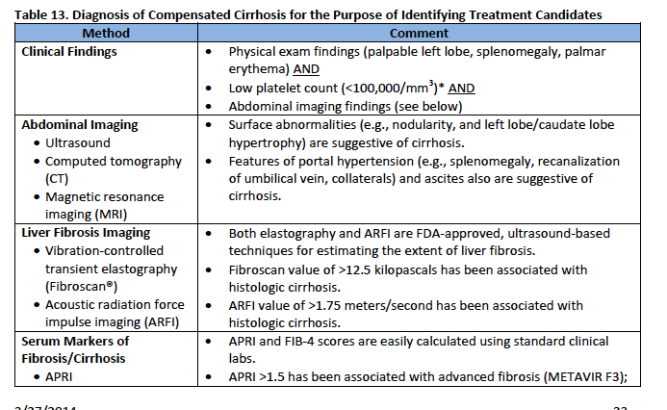
Noninvasive Staging of Liver Disease
http://www.hepatitis.va.gov/pdf/2014hcv.pdf
Notes:
Liver biopsy previous gold standard, now needed less, difficult to access for community based treatment
This is a nice table from the VA of some noninvasive testing options.

Slide 15
Staging of Liver Disease- Biomarkers One option- FIB-4
FIB-4 >3.25 has been associated with advanced fibrosis (specificity of 98%).
A value <1.45 has a sensitivity of 74% and specificity of 80% in excluding significant fibrosis
Ronald’s score: 4.59
http://gihep.com/calculators/hepatology/fibrosis-4-score/
Notes:
Another option is using serum biomarkers. Commercially available assays available but also calculations you can do yourself. We’re using the FIB-4 index.
Problem with all these noninvasive tests is they’re not very good for the middle ground

Slide 16
Primary Care
Slide credit: M. Beiser, BHCHP
Notes:
This is one management algorithm that the Boston HCH clinic is using, based on Hep C primary care guidelines from TWHC clinicians

Slide 17
HCV Patient Education
Slide credit: M. Beiser, BHCHP
Notes:
Even for patients not interested in treatment, education is going to be key

Slide 18
Cirrhosis
Slide credit: M. Beiser, BHCHP

Slide 19
Assessing Treatment Readiness
What is the risk of progression of liver disease?
What is the risk of infecting others?
Should we wait for newer treatments?
Is the patient motivated for treatment?
What are potential barriers to access/adherence?
Housing
Mental health
Substance use
Insurance
Notes:
I am hopeful we are moving towards universal treatment for all HCV+ patients, as we try to do with HIV. We’re not quite there yet.
So as we think about treating a patient now in 2014, we’ll be asking about risk of progression- EtOH, Hep B, insulin resistance. Is this person a driver of the epidemic?
Waiting for newer treatments- available before the end of 2014. Is pt motivated, will they show up? Tx is an investment and in many cases it’s not urgent. Are there any factors we can address prior to treatment? For some people, IFN was such a big deal that it became very motivational for getting sober, addressing depression, etc.- not sure how important that will be as treatment gets easier, but as we see with HIV, still plays a role.

Slide 20
Case Study
After hearing about the severity of his liver disease, Ronald is open to treatment if the side effects won’t be too bad.
“I don’t want to die from my liver after all that work to get sober.”
“My girlfriend is worried about catching it from me if we move in together.”
He faithfully attends every clinic appointment. He takes his diabetes meds regularly.
Notes:
Has both internal and external motivation for treatment
Promising markers of engagement in care and adherence

Slide 21
Slide credit: M. Beiser, BHCHP
Notes:
And when Ronald asks you again, but do I really need treatment?, you can show him this graph, because graphs always convince my pts, we see dramatic decreases in all cause mortality, cancer and liver failure.
Expect more data to come on the all cause mortality- we know the inflammation caused by HIV raises risk for CAD, other cancer, HCV may be doing the same thing

Slide 22
HCV Treatment Timeline
Source: Helm, 2013
Notes:
So what do we have to offer for treatment? This graph shows the evolution of treatment with SVR (cure) rates on L, time on the x axis. You can see we are already in the future.

Slide 23
Slide credit: M. Beiser, BHCHP
Notes:
This change is happening fast. By the end of 2014, we should be leaving IFN, and in many cases RBV, behind.

Slide 24
Newest Hepatitis C Treatments
Drug | Mechanism | Indicated for | Dosing | Considerations
Sofosbuvir | NS5B polymerase inhibitor | Genotype 1, 2, 3 or 4 infection, including HCC awaiting transplant and HIV coinfected With PEG/Riba, Riba alone or off label with Simepravir | 400 mg tablet once daily (with or without food) | Well tolerated, can cause fatigue, headache Minimal drug interactions
Simepravir | NS3/4A protease inhibitor | Genotype 1 (with PEG/Riba) Most of use to date off label with Sofosbuvir | 150 mg tablet once daily (with or without food) | Generally well tolerated, can cause rash, pruritus, nausea, photosensitivity, myalgia and dyspnea, bilirubin elevation Caution with inducers/inhibitors of CYP3A
Notes:
These are our currently available DAAs.

Slide 25
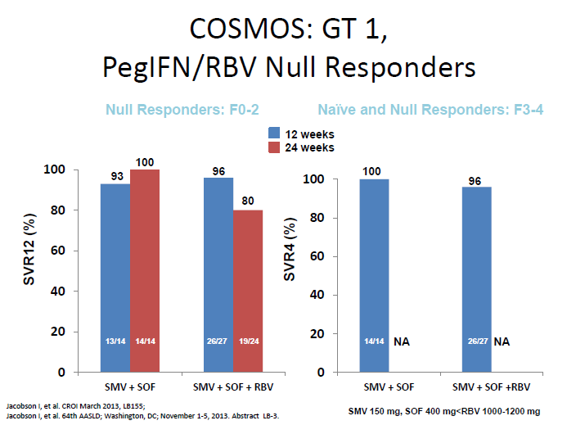
Data supporting Simepravir/Sofosbuvir off-label use
Notes:
And this is why we’ve been using Sim/Sof off label. COSMOS looked at prior null responders, inc compensated cirrhotics. I won’t show you too many graphs, because they all look like these. Small study.

Slide 26
Slide credit: M. Beiser, BHCHP
Notes:
This is what we’re waiting for in Oct- 2 drug combo sof/led, inc compensated cirrhotics, cures as short as 8 wks for naïve. How short can we go? Shorter treatment durations really open the door for treating even pretty unstable homeless pts- could do DOT, maybe respite services available, treat while in a rehab program, jal? A lot of people could get through 4 weeks.

Slide 27
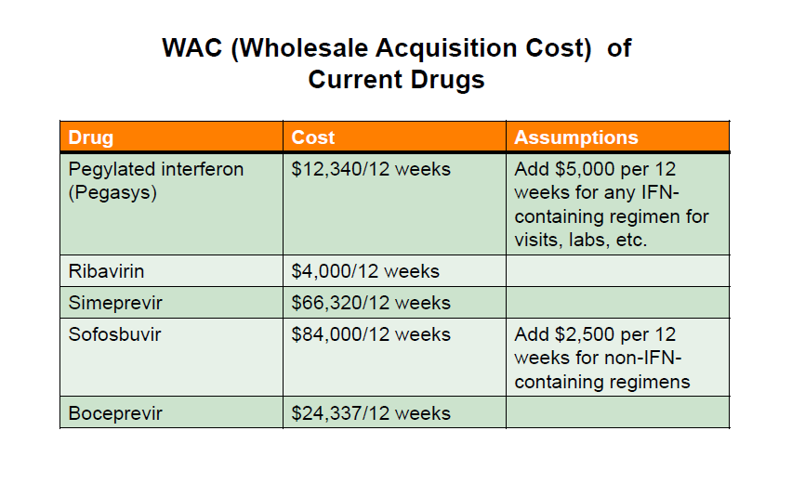
Cost and Efficacy of Current Treatment
Source: P. Pockros, presented at 2014 Scripps Liver Conference
Notes:
What has made the news recently is primarily cost. Sof- $1000/pill getting the most publicity. This is data put together by Dr. Pockros at Scripps looking at cost effectiveness at this point in 2014 (all this will be out of date in 2 mos)

Slide 28
Source: P. Pockros, presented at 2014 Scripps Liver Conference
Notes:
You can see that even with good cure rates, cost/cure is still >100K, as SVRs go down, becomes less cost effective

Slide 29
Cost of Hepatitis C Treatment
If every patient in California with advanced liver damage were treated, the cost would be $6.3 billion (CTAF)
Could increase premiums for Medicare Part D by 3-8% next year, even if only a fraction of patients treated (Kaiser Family Foundation)
Gilead Sciences sold $2.27 billion worth of Sovaldi in the first quarter of 2014 (NPR, April 2014)
Notes:
Kaiser estimated treating 10% of already dx HCV patients.
Unlike many other countries, US law prevents regulation of drug prices

Slide 30
Cost Effectiveness
Modeling studies demonstrate potential for Treatment as Prevention among IDUs in urban centers (Martin et al, 2014)
Many studies suggest long-term cost effectiveness, even at high price points (Hagan et al, 2014)
“Downstream costs” of HCV are high
Liver transplant can cost $300K
Notes:
Expensive treatments can still be cost effective in the long term. However, payer covering Sof may not be the same payer covering your 18th admission for bleeding varices, which changes the incentives.
Challenging for me because I feel like very little of my work with homeless patients is cost effective- we routinely use ER care because of lack of housing, lack of access to specialists. We miss opportunities for prevention all the time.
I would like to see disc about hep c treatment in the context of larger discussions around drug pricing, around access to care. These argument very easliy become a way to deny treatment access for the patients most at risk, especially those using drug or alcohol who are seen as “undeserving”
We can learn a lot for HIV advocates who simulataneously advocate for access and lower costs.
Sof in Egypt (where 1/5 baby boomers is HCV infected) will be 99$/course

Slide 31
Who to Treat: MediCal Guidelines
For genotypes 1,2, and 3, patients with mild liver disease, except for those with serious extra-hepatic manifestations or post-liver transplant, are not eligible for Sofosbuvir- or Simeprevir-based regimens
Patients with a substance abuse disorder must be actively participating in treatment for the disorder or be abstinent for 6 months prior to the initiation of HCV treatment
http://www.dhcs.ca.gov/Pages/HepatitisC.aspx
Notes:
Since we’re at a regional training, I’ll review the MediCal guidelines released last month. There was a lot of advocacy, especially around treatment for substance users.

Slide 32
Who to Treat: AASLD Guidelines
Treatment is recommended for patients with chronic HCV infection.
Treatment is assigned the highest priority for those patients with advanced fibrosis, those with compensated cirrhosis, liver transplant recipients, and patients with severe extrahepatic hepatitis C
Based on available resources, treatment should be prioritized as necessary so that patients at high risk for complications are given high priority
Treatment of individuals at high risk to transmit HCV to others may yield long-term future benefits from decreased transmission.
MSM with high-risk sexual practices
Active injection drug users
Incarcerated persons
Persons on long-term hemodialysis
http://www.hcvguidelines.org/
Notes:
National guidelines are a little more inclusive and include a disc. Of the benefits of treatment as prevention.

Slide 33
Patient/Copay Assistance Programs
So far, very generous
Requires documentation of a denial of coverage for insured patients
Contact Information
Johnson & Johnson (Simeprevir)
800-652-6227 or www.jjpaf.org
Gilead Sciences (Sofosbuvir)
855-769-7284 or www.MySupportPath.com
http://www.hepmag.com/articles hepatitis_paps_copays_20506.shtml
Notes:
For patients who are uninsured or denied by MediCal, PAPs are a good option. For our MediCare pts, the copay assistance programs have been essential

Slide 34
What about Reinfection?
Has been demonstrated among MSM, IDU (Grebely, 2012; Inglitz, 2014., Sacks-Davis, 2013)
Studies show variable risk- May be associated with increased rate of spontaneous clearance (Grady, 2013)
Patient education needed before treatment
We don’t defer treatment for other infectious diseases for this reason
Notes:
Will be interesting to see if easier treatment leads to more reinfections

Slide 35
What about Community Based Treatment?
Benefits | Challenges
Treatment regimens are simple and well tolerated | Need to build provider and team capacity
May be more cost effective | Treatment cost and access
Many sites have a care team to support treatment readiness and adherence | Staging may be more challenging
Patient centered, increases access | Risk of decompensation or treatment failure for patients with advanced disease?
Notes:
Next let’s talk about where we treat

Slide 36
Mission Neighborhood Health Center Hepatitis C Pilot
Offering treatment to HCV mono-infected patients in a FQHC setting
HCH satellite clinic is the primary referral site
Utilizing the staff of the multidisciplinary HIV care team for health ed, case management, nursing support

Slide 37
Mission Neighborhood Health Center Hepatitis C Pilot Challenges
Navigating prior authorization/patient assistance program paperwork
Figuring out how much pretreatment assessment and support patients really need
Slow uptake of referrals among patients and providers
Lack of screening
Persistent patient concerns about treatment toxicity
Competing life/health priorities

Slide 38
Case Study Conclusion
Ronald is referred to the MNHC treatment pilot. Based on his diagnosis of compensated cirrhosis, he is offered treatment now.
He discloses a history of depression with multiple suicide attempts while in jail so is deemed interferon ineligible
He completes 12 weeks of Sofosbuvir + Simepravir + Ribavirin and successfully clears his Hepatitis C

Slide 39
Conclusions
SCREEN | Consider universal Hep C screening for all homeless patients
STAGE | Consider FIB-4 or other testing to stage liver disease for HCV+ patients and prioritize treatment
PROVIDE PRIMARY CARE | Educate HCV+ patients, assess EtOH use, offer vaccinations, treat comorbidities, screen for HCC if cirrhotic
TREAT | Consider building capacity for community based treatment or enhanced referrals

Slide 40
Resources
Treatment Guidelines
AASLD and IDSA guidelines www.hcvguidelines.org
University of Washington online study moduleshttp://www.hepatitisc.uw.edu/browse/all/lectures
Hepatitis C news and conference proceedings
www.natap.org
www.hivandhepatitis.com
Advocacy and patient education
Project Inform http://www.projectinform.org/category/hepc/
HepMag www.hepmag.com
Hcvadvocate.org
National Viral Hepatitis Roundtable www.nvhr.org

Slide 41
Acknowledgements
Marguerite Beiser, NP, Boston Healthcare for the Homeless Program
Dr. Cami Graham, BIDMC
Dr. Paul Pockros, Scripps Clinic
My team at MNHC
Patients, Providers and Advocates fighting for access to HCV treatment

